Slide 1
Refining fault zone mapping approaches and examples
GLG494/598 (ASU) and GEOL 701J (UNR): Mapping tectonic faults from geomorphology
Ramón Arrowsmith
ramon.arrowsmith@asu.edu

Slide 2
What is the fault rupture hazard at sites near active faults?
First step is what we are doing in our class which is to MAP fault traces and deformation zones active in the recent geologic past.

Slide 3
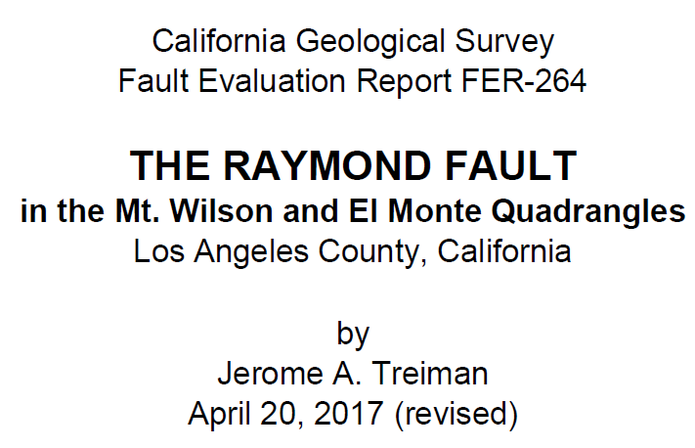
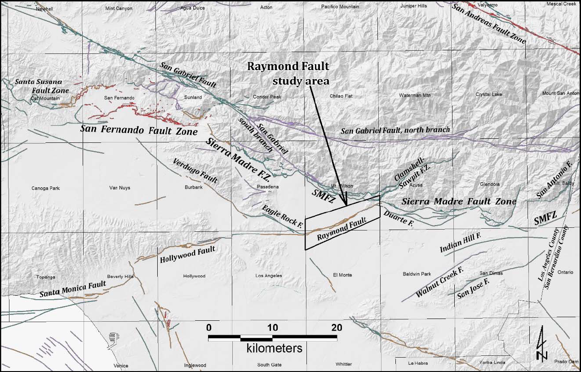
Plate 2 is useful for the class – A tectonic geomorphic map that Jerry produced, mostly from older airphotos (although the topo base shows many of the features pretty well). I think Plate 3 helps illustrate the evolution of many pieces of data into a unified fault map.
-Dawson

Slide 4
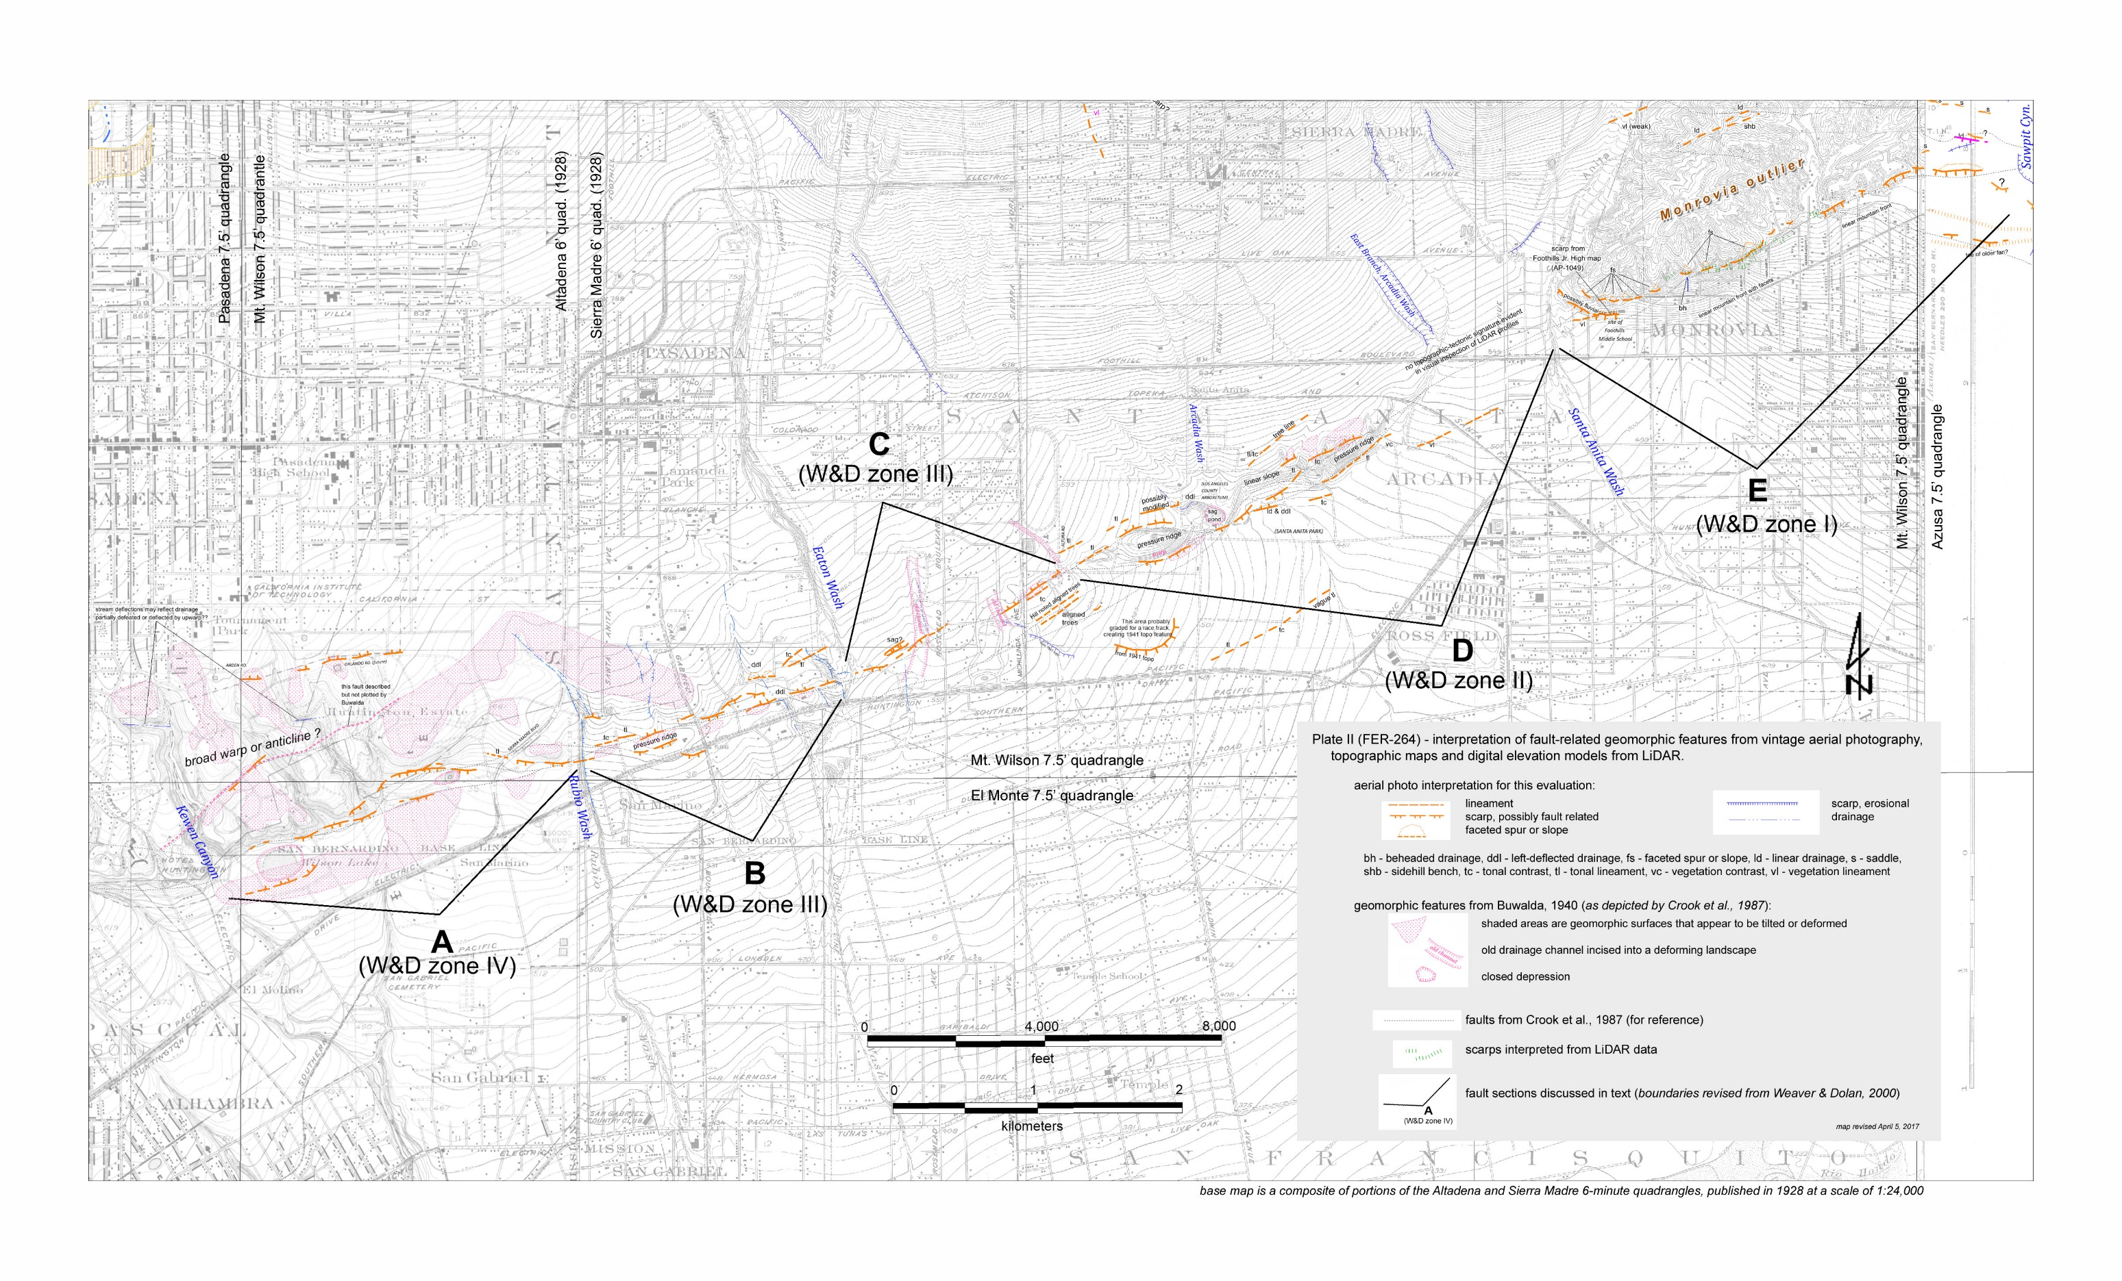

Slide 5
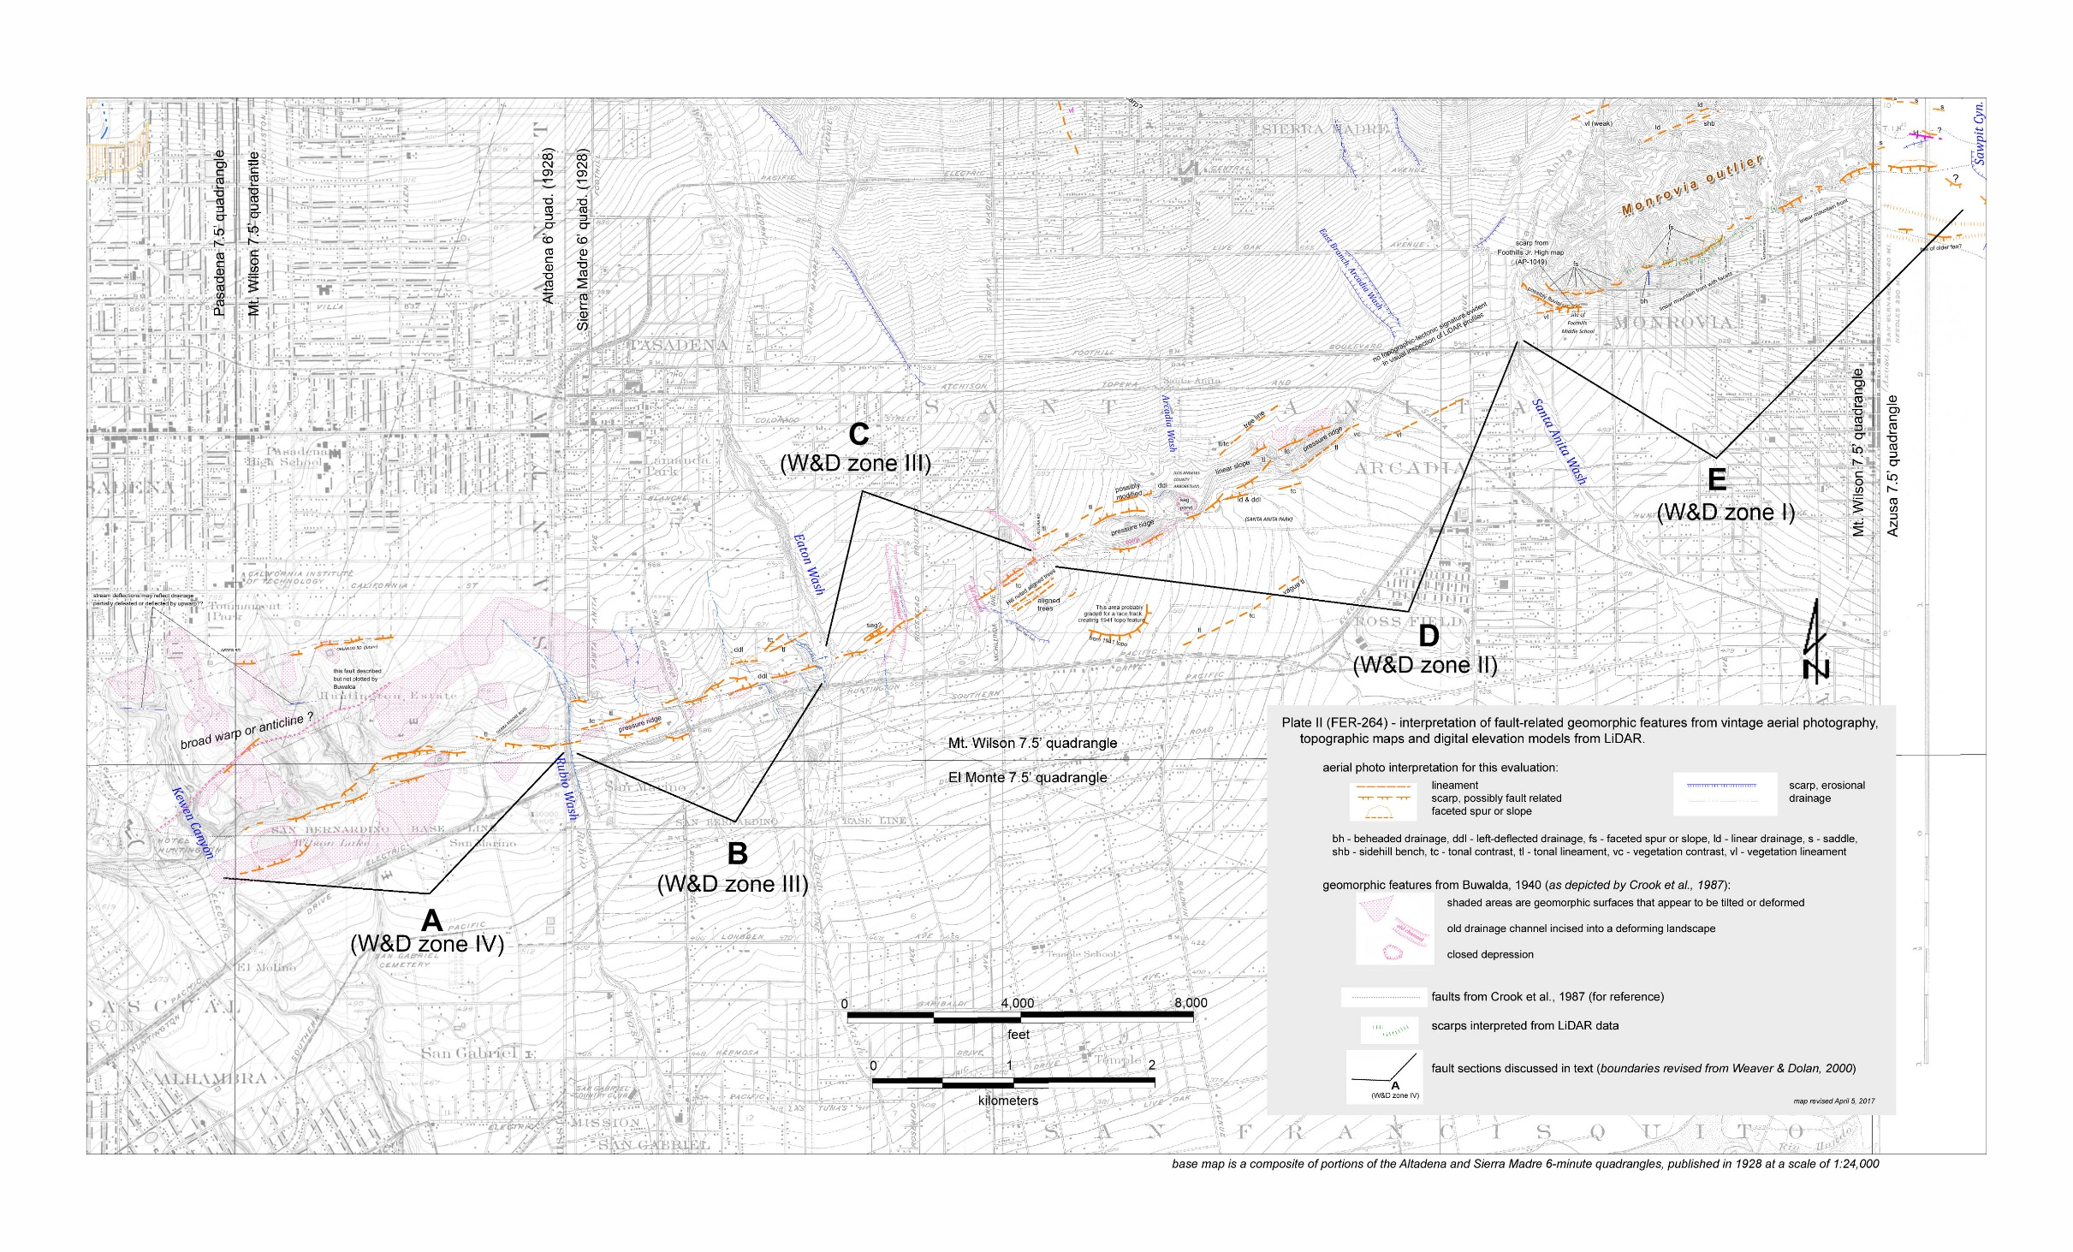

Slide 7
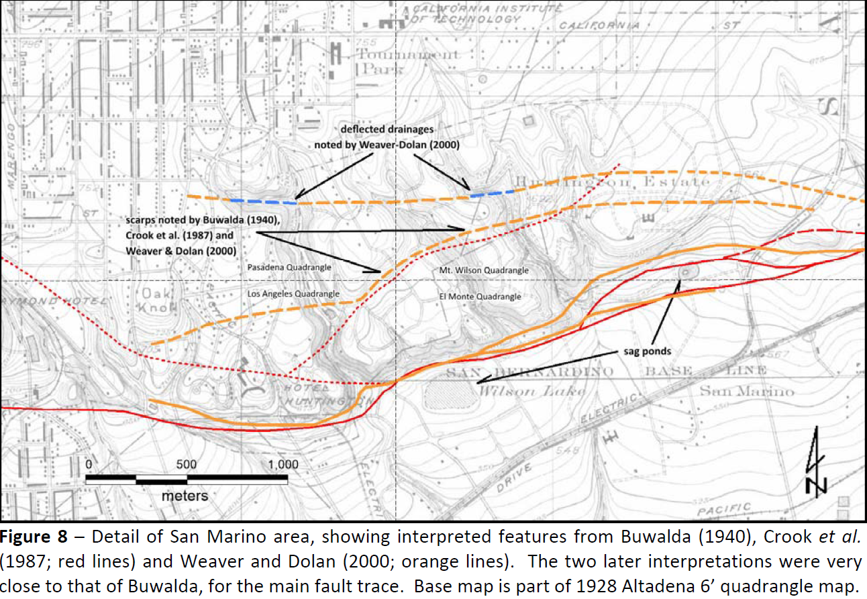

Slide 9
From the standpoint of improving PFDHA models for hazard, it will be most helpful to have the pre-rupture maps reflect the current standard of practice for mapping fault location, location uncertainty, etc. This standard of practice does pay attention to reasonable geologic constraints and follows well-traveled heuristics [“rules-of-thumb”] about which features are good proxies for active faulting versus differential erosion/not active faulting.
The comparison of pre- and post-rupture mapping should be the objective test for us all to learn how well the fault mapping—following current best practices—serves as a predictive tool for future surface-fault rupture. We want to use this comparison to develop additional data for calibration of the PFDHA models, as well as assess the best approaches for producing useful map data.
-S. Thompson

Slide 10
The challenge for us then is to balance moving our mapping closer to the standards of practice without also introducing too much additional bias. [somewhat generic educational challenge for many situations]
We have a great opportunity with our motivated group of geoscientists to address these issues

Slide 11
Mapping Strategies, Guidance, Considerations
Generic geologic, geomorphic, morphologic mapping standards
California Geological Survey active fault guidelines
McCalpin flow chart
Controls by slip rate, fault type, vegetation and anthropogenic changes, active and paleosurface processes
Many examples (heuristics by demonstration)

Slide 12
Quality rating for our maps
Basic rules
Bedrock and Quaternary geology correctness
Missing features & Uneven coverage
Consistency
How to document your decision making? Is the feature related to active tectonics
Are the lines you have drawn supported by the observations?

Slide 13
Active faults—defined by recency of last ground deformation
USGS Quaternary faults 5 classes: Historic, Holocene to Latest Pleistocene, Late Quaternary, Mid-Late Quaternary, Quaternary (https://www.usgs.gov/natural-hazards/earthquake-hazards/faults)
California Geological Survey maps: Holocene (<12ka)
California Division of Dams: Late Pleistocene (<35ka)
Holocene is post Last Glacial Maximum
to 2.588Ma

Slide 14
http://quaternary.stratigraphy.org/charts/

Slide 16
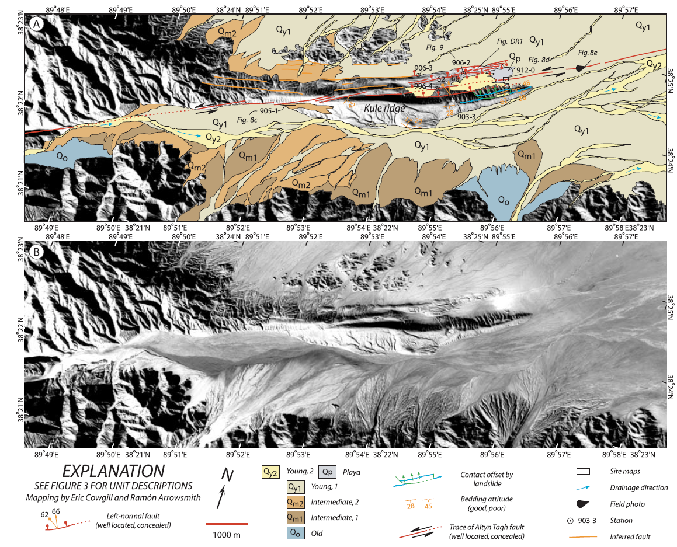

Slide 17
Cowgill, E. Arrowsmith, J R., Yin, A., Xiaofeng, W., Zhengle, C., The Akato Tagh bend along the Altyn Tagh fault, NW Tibet 2. Active deformation and the importance of transpression and strain-hardening along the Altyn Tagh system, Geological Society of America Bulletin, 116, p. 1443--1464, 2004.

Slide 19
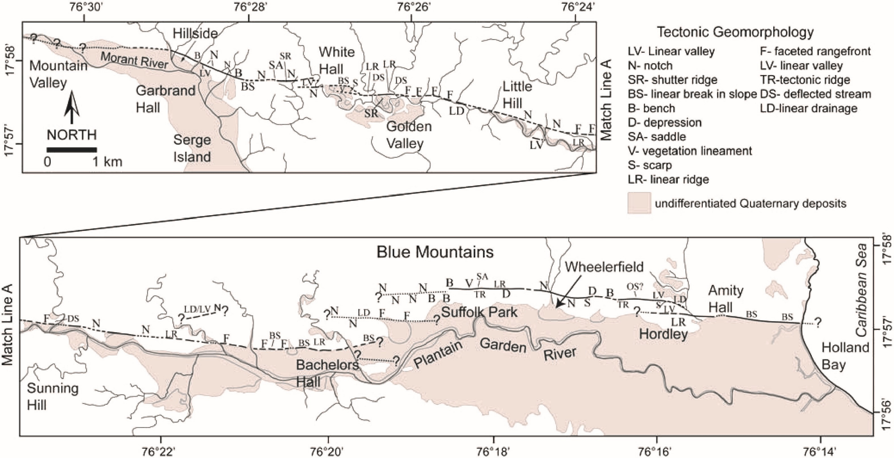

Slide 23
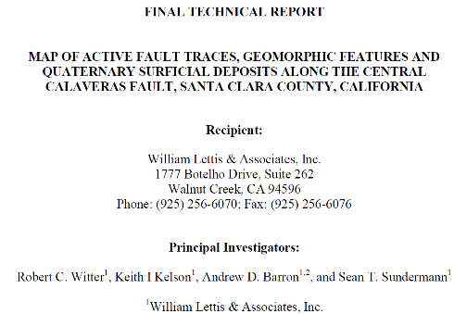
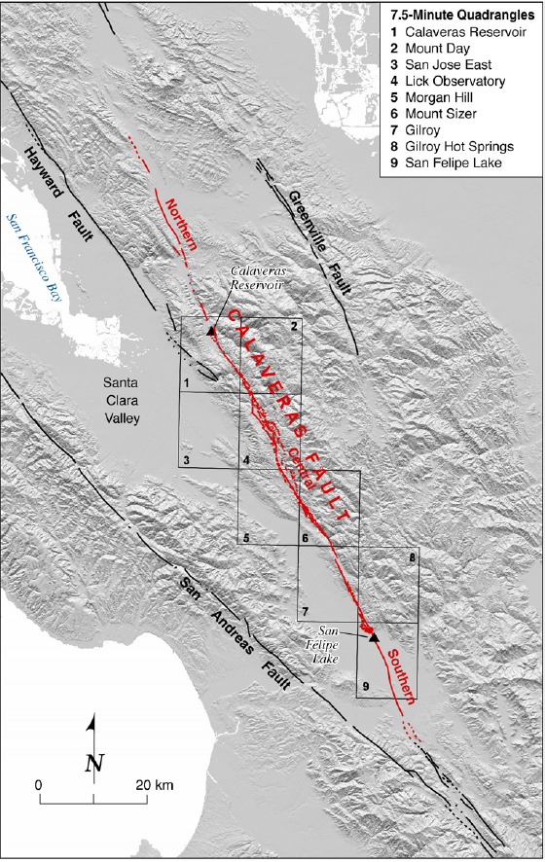
Geomorphic features are ranked according to a scale of clarity by using the following codes:
G1 indicates strongly pronounced features;
G2 indicates distinct features;
G3 indicates features with weaker expression.
Features of uncertain tectonic origin are queried.
The geomorphic codes do not reflect the degree of confidence in the judgement that particular fault traces are of Holocene age. Instead, where evidence for Holocene displacement is less certain, the map delineates the fault trace as a dotted line or queried dotted line.
The accuracy of active fault locations relates to the clarity of geomorphic expression as well as any additional lines of evidence that accurately delineate the fault. For example, sections of the fault characterized by strongly pronounced and distinct features (G1 or G2) that coincide with creep evidence and/or geological evidence for Holocene displacement can be more accurately located than ambiguous fault traces defined by weakly expressed features that lack evidence for creep or geologic information derived from paleoseismic trenches.
Uncertainty in the location of fault traces is expressed by varying line types in the following way: (1) solid lines indicate well located traces (≤±25 m); (2) dashed lines indicate traces located with less certainty (≤±50 m); and (3) dotted lines indicate concealed or inferred fault traces (≤±75 m).
Follows Lienkaemper, J.J., 1992, Map of recently active traces of the Hayward Fault, Alameda and Contra Costa Counties, California: U.S. Geological Survey Miscellaneous Field Studies Map MF-2196, map scale 1:24,000, 13 p.

Slide 24
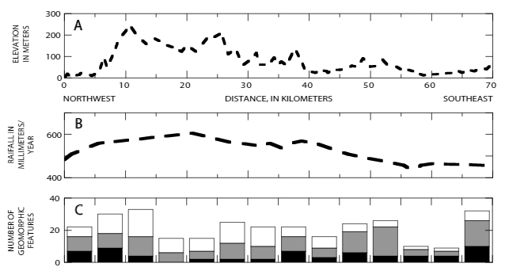
Quality assessment
Hayward fault-related geomorphic features (black, G1; dotted, G2; white, G3) (Lienkaemper, 1992)
https://www.researchgate.net/publication/237789684_Map_of_recently_active_traces_of_the_Hayward_fault_Alameda_and_Contra_Costa_counties_California

Slide 25
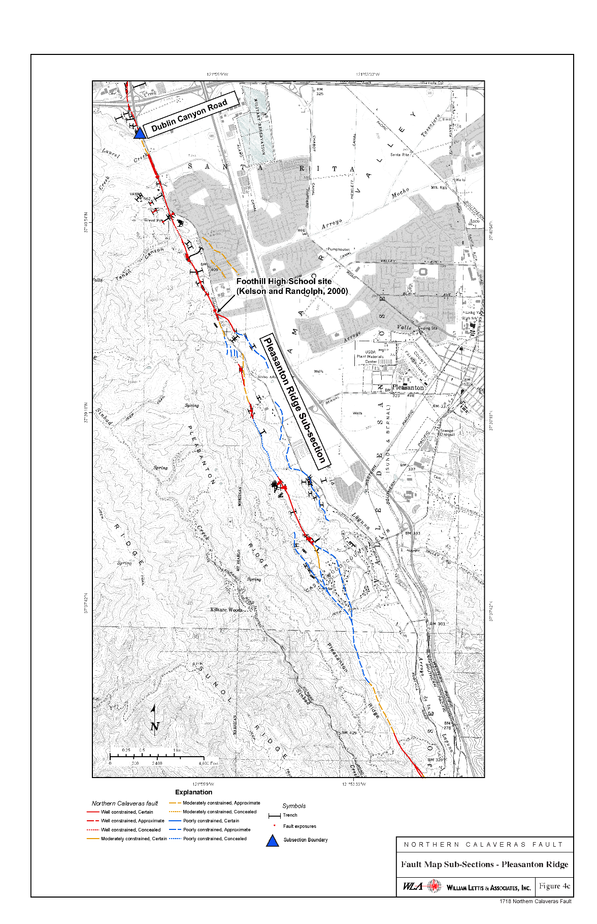
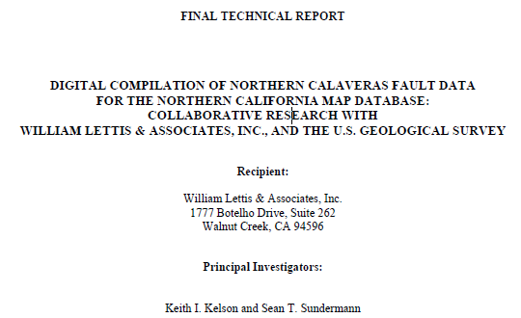

Slide 26
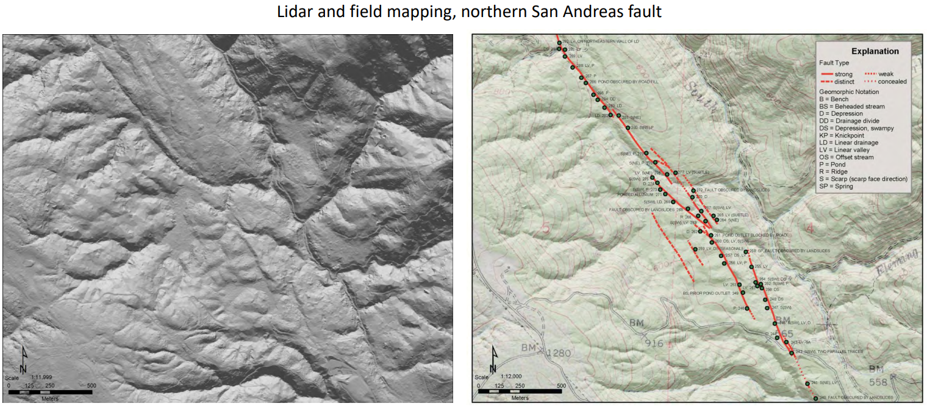
line types and geomorphic indicators
http://activetectonics.asu.edu/mapping_active_faults/Lectures/Strike_slip_koehler.pdf

Slide 28
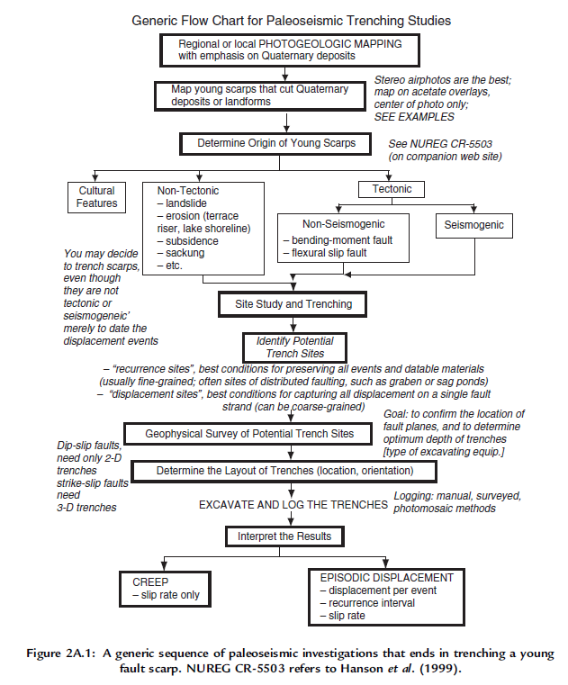
McCalpin textbook

Slide 30
Typical CGS Workflow for Active Fault Mapping
California Department of Conservation | conservation.ca.gov
6

Slide 31
Typical CGS Workflow for Active Fault Mapping
High, moderate, low categories are relative.
Advisable to have some examples from the project area illustrating how you, as the mapper, assign the categories.
Context is important. A single feature, for example, a spring may have a low- confidence rating that it is fault related. However, put into the context with other features (on-trend vegetation lineaments), the same feature may be assigned a high-confidence rating.
California Department of Conservation | conservation.ca.gov
7

Slide 32
Geodatabase Schema
Geodatabase can be as simple or as complex as desired. The level of complexity depends on what the geodatabase will be used for and should consider what is practical in terms of time and effort to populate. Fields with specified values typically reserved for DB queries and symbology.
California De | Type | Specifies the kind of feature represented by the line. For example, "fault", ”scarp” “vegetation lineament", “linear ridge", etc. Can be populated with dropdown values. Nulls not permitted
 | Location Confidence | Half-width in meters of positional uncertainty envelop; position is relative to other features in database. Null values not permitted. Recommend value of -9 if value is not available. Suggested distances qualitatively described in "Feature-level metadata" document
 | Existence Confidence | Values = "certain", "questionable", "unspecified". Null values not permitted. Suggest setting default value to "certain"
 | Identity Confidence | Values = "certain", "questionable", "unspecified“. Alternative: “High”, Moderate”, “Low”. Null values not permitted. Suggest setting default value to "certain"
 | Data Source | Imagery used for interpretation, e.g. NCALM lidar, NAIP, 1:5,000 airphotos
 | Mapping scale | Mapping scale of either linework, or project (if set mapping scale used).
 | Comments | Optional. Free text for additional information specific to this feature. Null values permitted.
 | Mapper | Name of mapper
 | Mapper Affiliation | Affiliate of mapper, commonly recognized abbreviations (e.g. CGS, USGS, UNR) acceptable.
partment of Conservation | conservation.ca.gov
8

Slide 33
Feature Classes
What feature class to use is often scale-dependent.
Lines: Linear features such as faults, tonal lineaments, linear valleys, deflected drainages
Points: Smaller features such as springs, saddles, small depressions, places that you want to annotate with a comment
Polygons: Larger features such as pull-apart basins, triangular facets, linear ridges/pressure ridges, offset surfaces.
California Department of Conservation | conservation.ca.gov
9

Slide 34
Attribute fields
ArcGIS (not sure about QGIS) has the ability to have dropdown lists in the attribute fields that help enforce consistence and aids in filling out attributes.
Some examples of what CGS uses: Type (Origin) California Department of Conservation | conservation.ca.gov | Feature type Dropdown list | 10
 | Uphill-Facing Scarp
 | Beheaded Drainage
 | Break in Slope
 | Closed Depression
 | Deflected Drainage, left lateral
 | Deflected Drainage, right lateral
 | Drainage Knickpoint
 | Faceted Spur
 | Linear Drainage
 | Linear Trough
 | Notch
 | Offset Cultural Feature
 | Ponded Alluvium
 | Pressure Ridge
 | Offset Ridge, left lateral
 | Offset Ridge, right lateral
 | Saddle
 | Scarp
 | Shutter Ridge
 | Side-Hill Bench
 | Spring
 | Swale
 | Tonal Lineament
 | Trough
 | Vegetation Lineament
 | Sag Pond
 | Mole Track
 | Linear Front
 | Offset Drainage, right lateral
Offset Drainage, left lateral

Slide 35
Example of CGS FER geomorphic map and A-P Zone map
Boundary of Alquist – Priolo Zone
Inferred
Concealed
Approximately
Geomorphic map
California Department of Conservation | conservation.ca.gov
Active Fault map
From Hernandez (2017) CGS FER 258
located
11

Slide 37
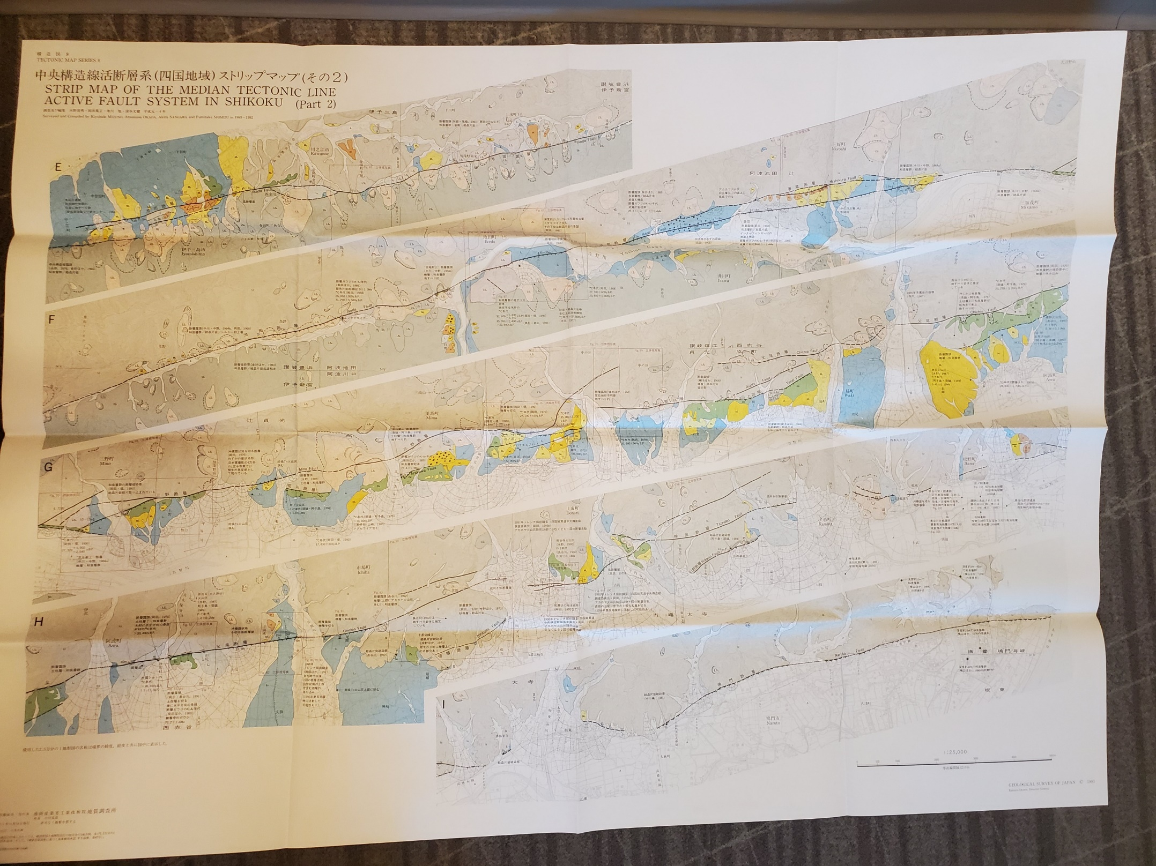
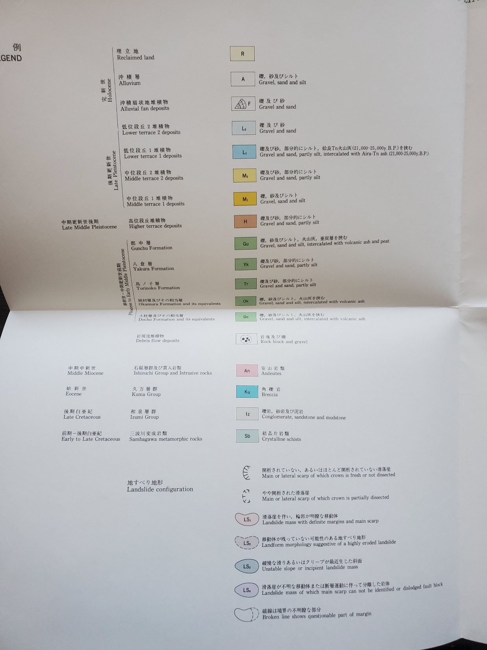
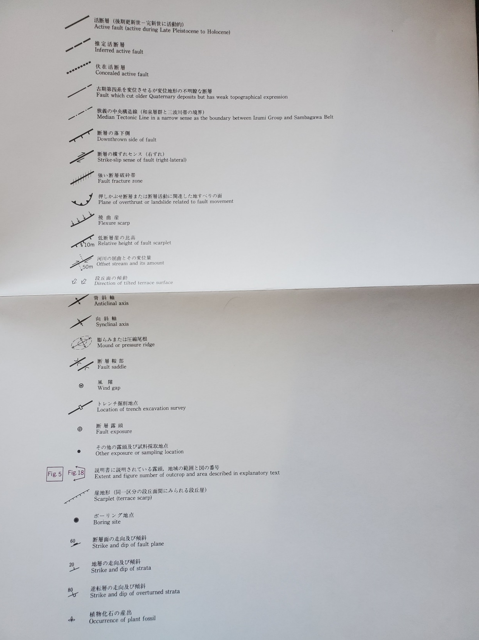

Slide 38
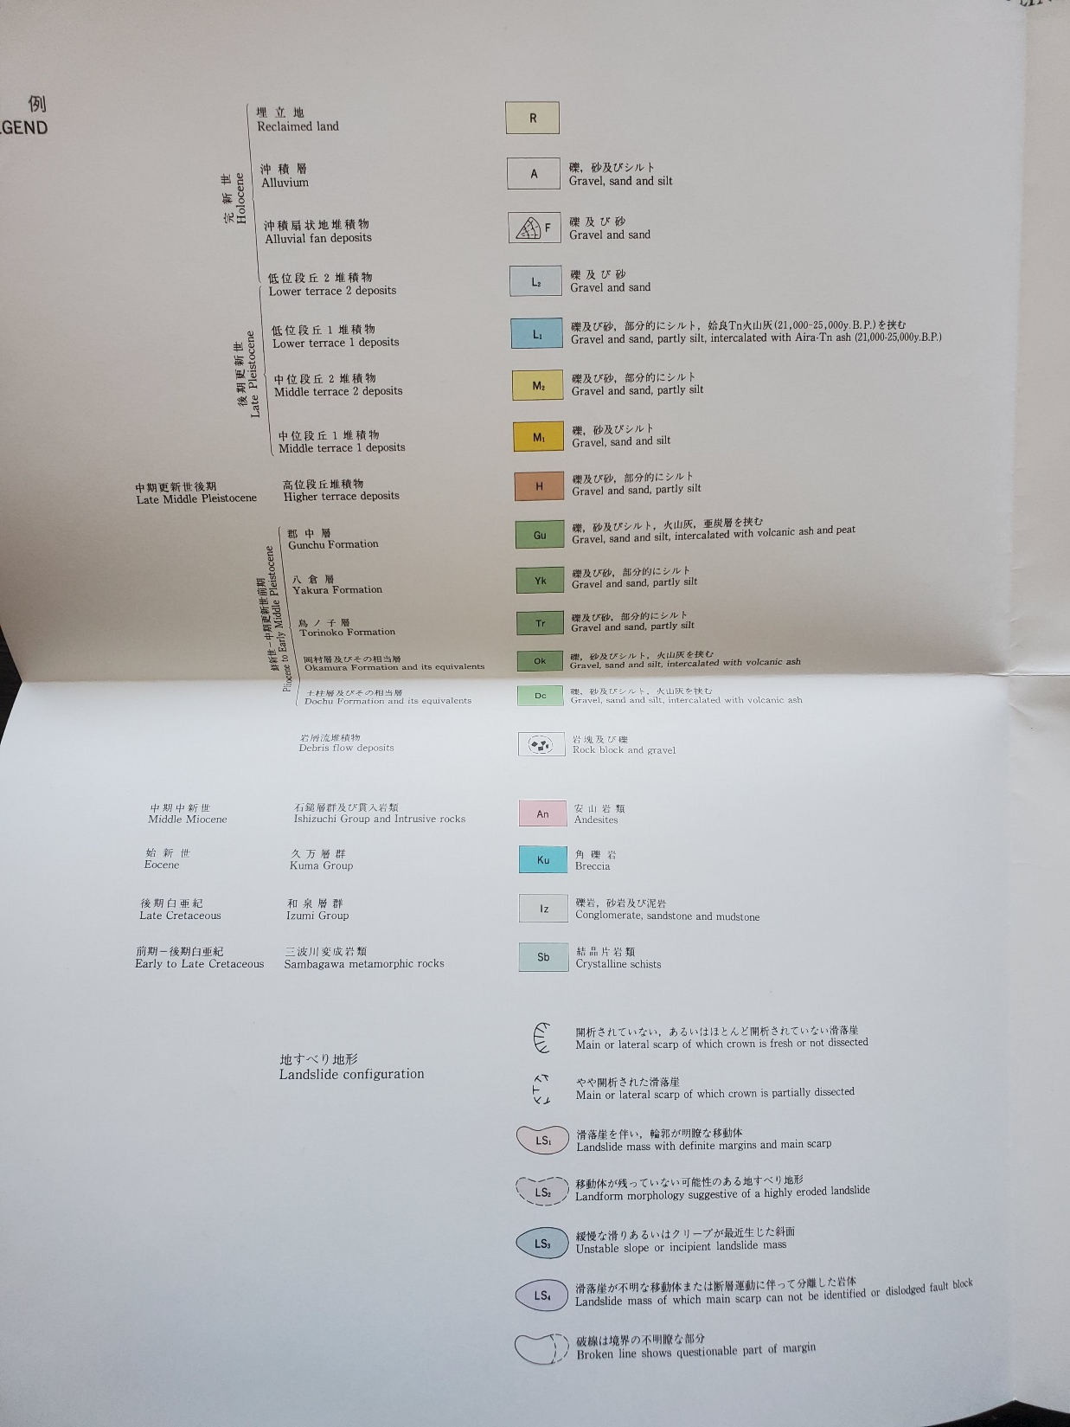
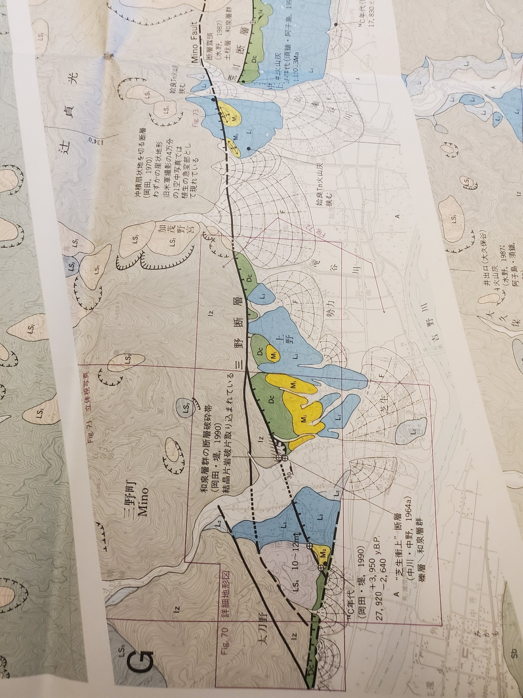

Slide 39
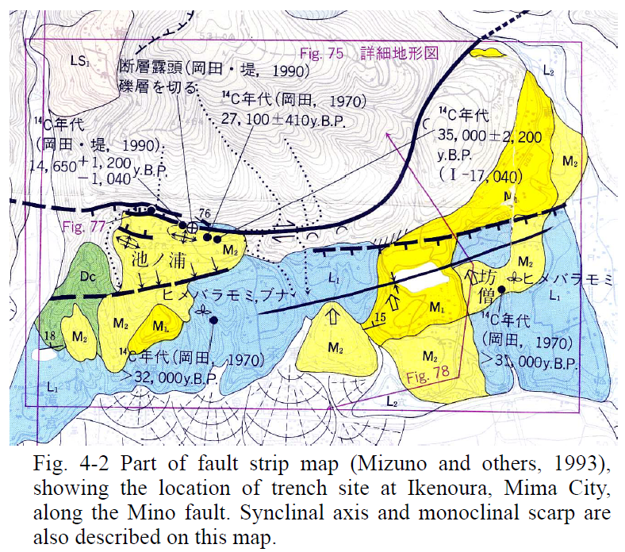
Japanese active fault map (from Okada and Ooi field trip guide, 2006)

Slide 40
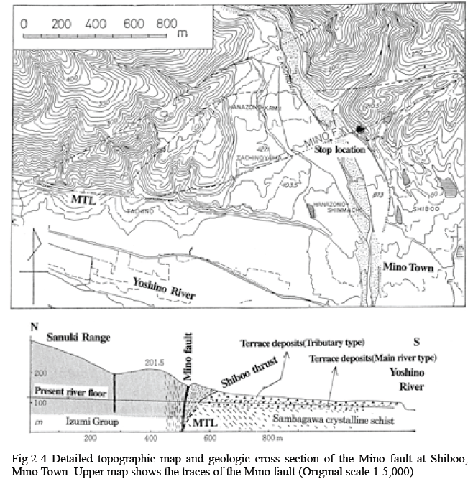
Japanese active fault map (from Okada and Ooi field trip guide, 2006)

Slide 41
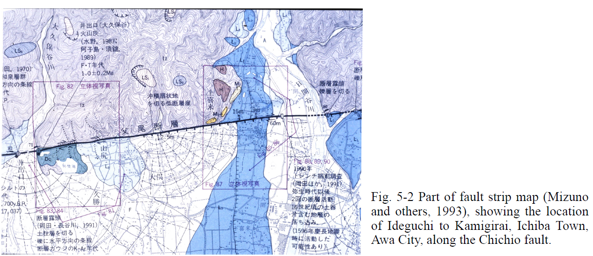
Japanese active fault map (from Okada and Ooi field trip guide, 2006)

Slide 42
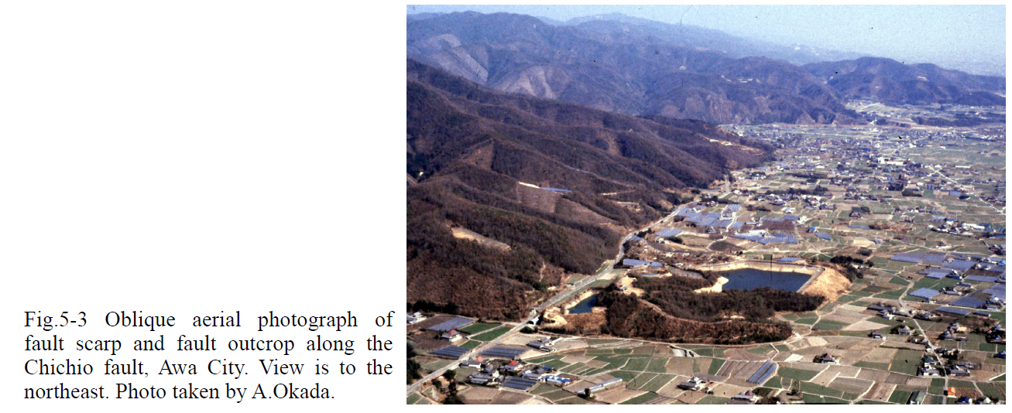
Japanese active fault map overview for prior slide (from Okada and Ooi field trip guide, 2006)

Slide 43
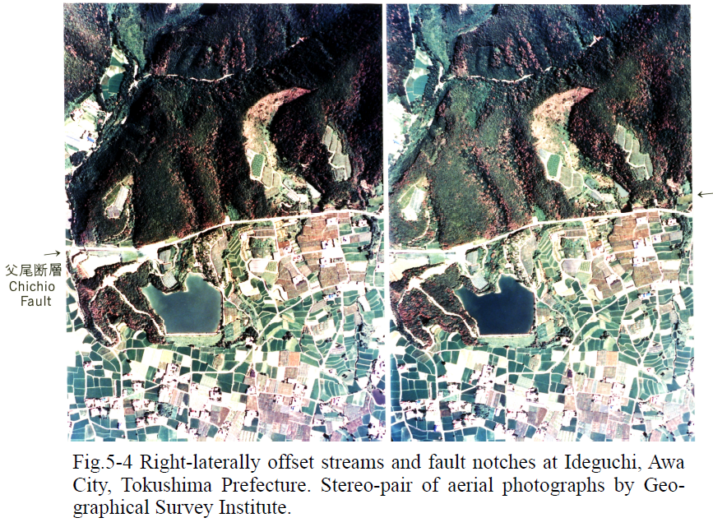
Japanese active fault map stereopair for prior slide (from Okada and Ooi field trip guide, 2006)

Slide 45
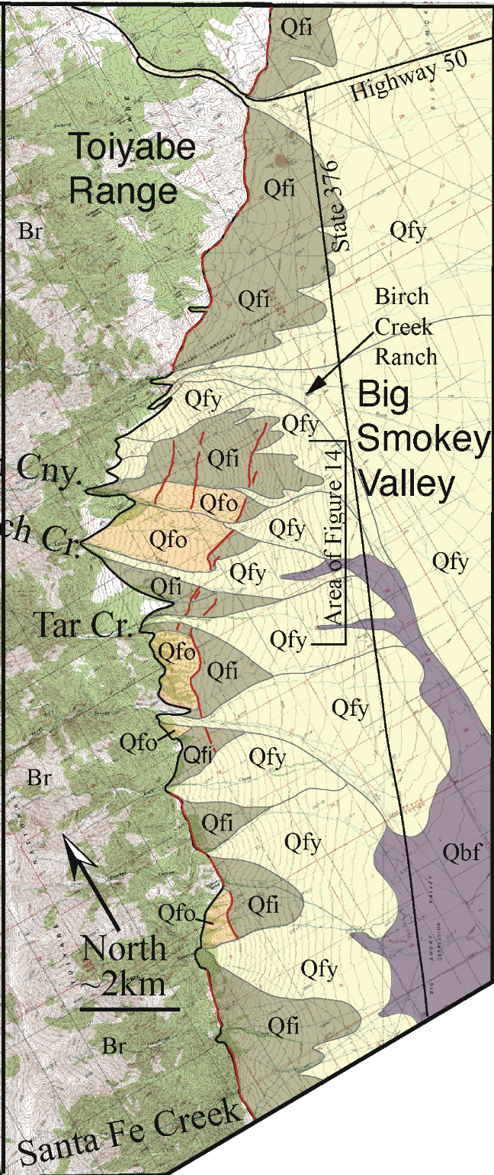
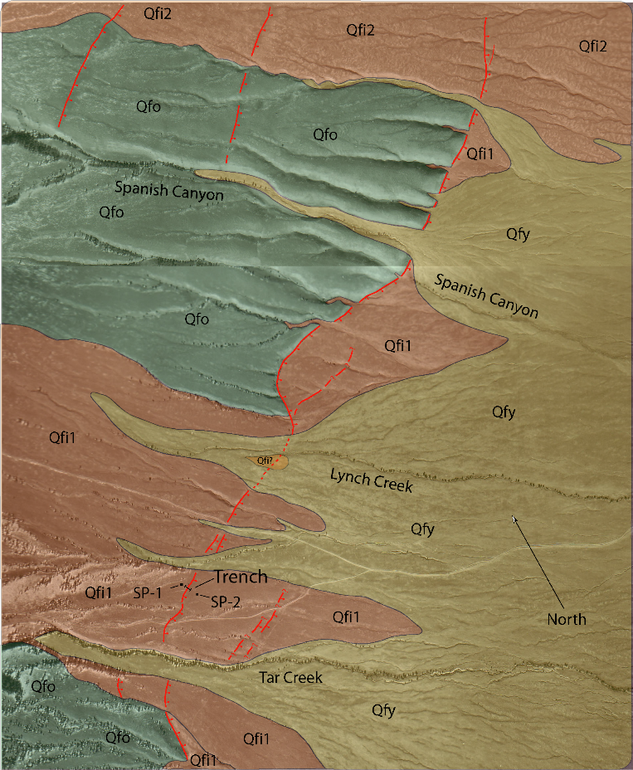
Use of photos and Quat. geology to find fault traces
Toiyabe fault, Nevada
Fault traces mapped using:
Aerial photographs
Field evaluation
-Koehler

Slide 46
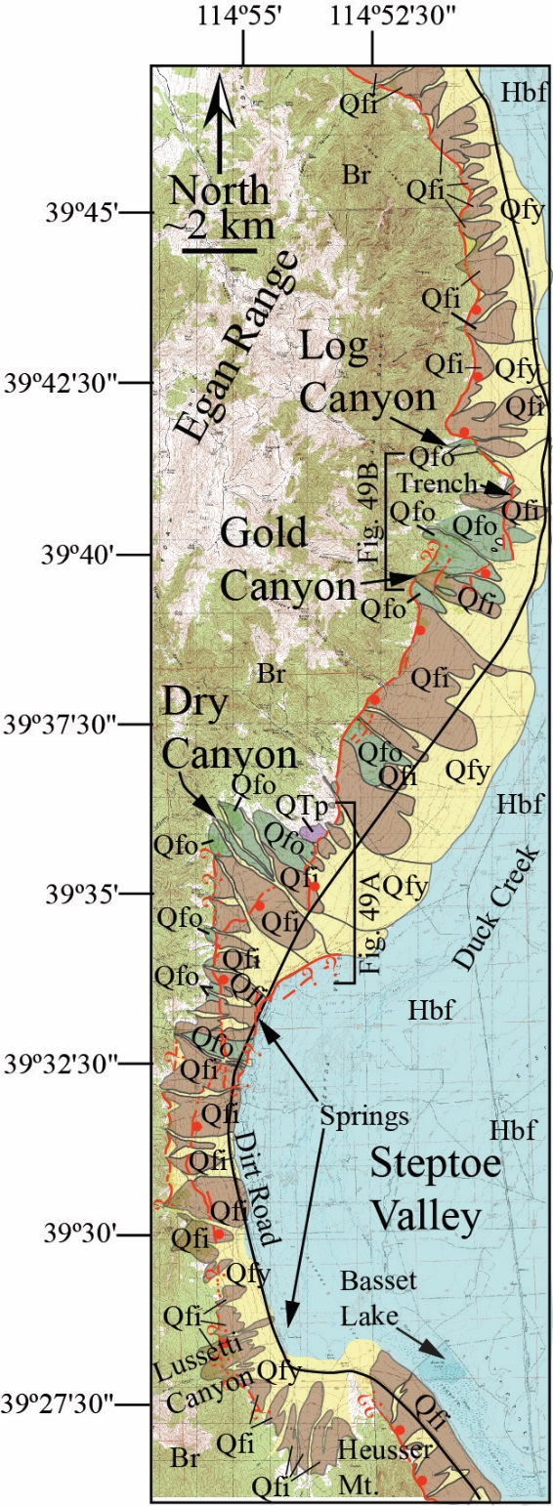
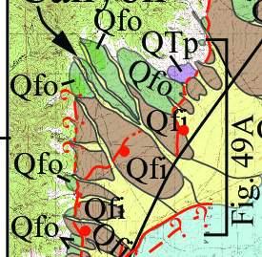
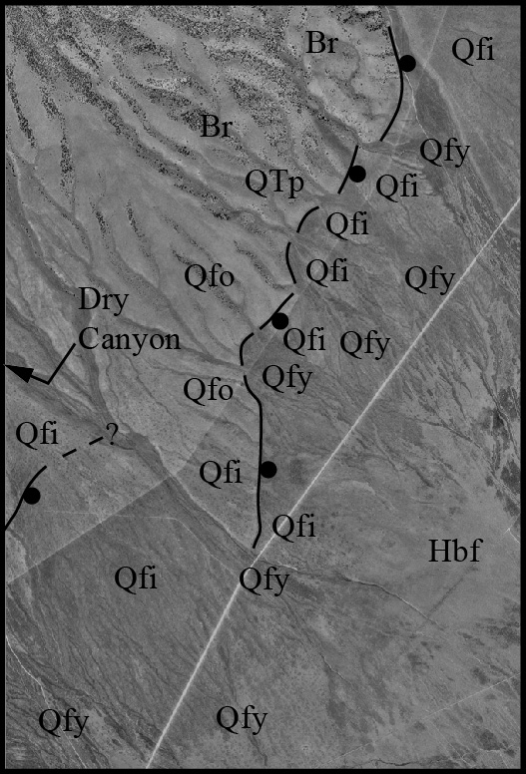
Use of photos and Quat. geology to find fault traces
Egan Range fault, Nevada
-Koehler

Slide 48
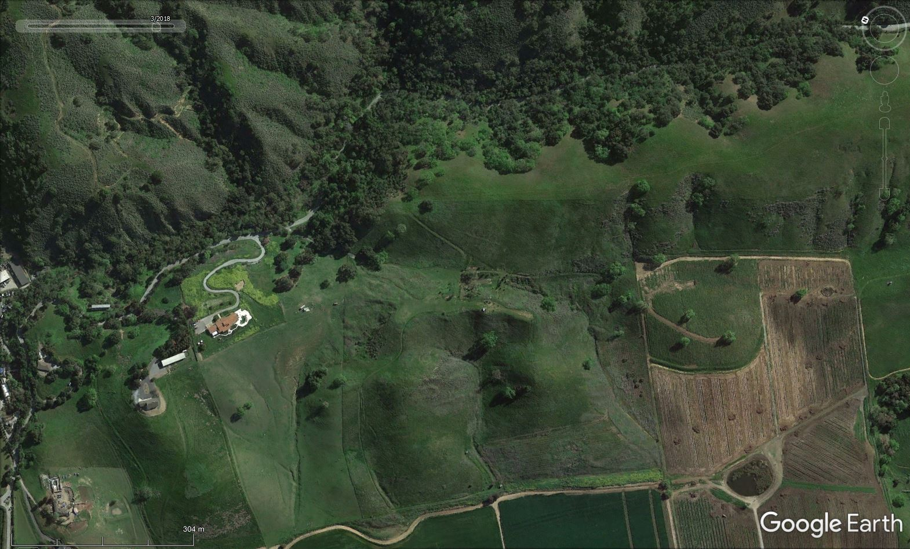
Consistency of features observed along strike at different scales, yet still have good examples of uncertainty (e.g. which side of a trough or valley does the main strand go).
Calaveras Fault
9-20 mm/yr
Creeping
-Madugo

Slide 49
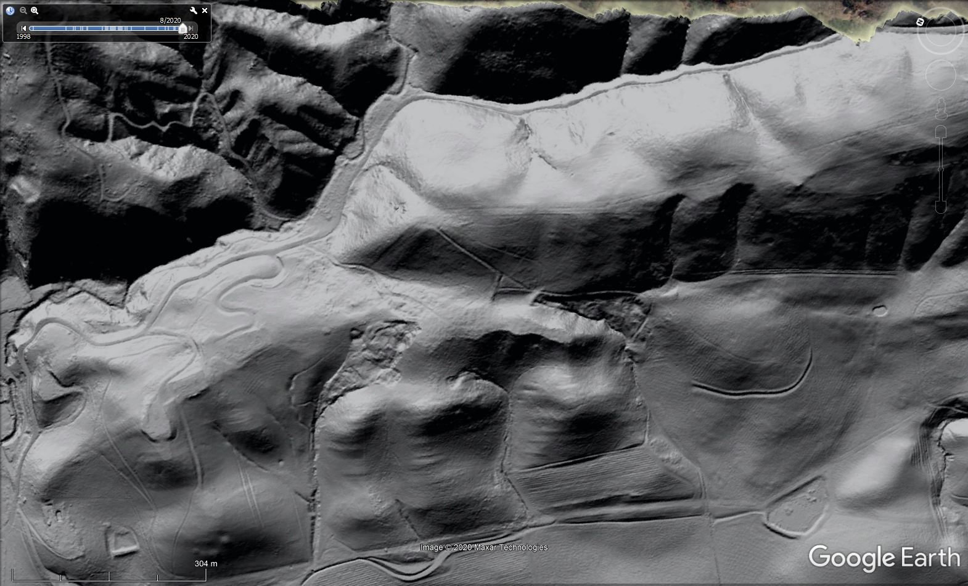
-Madugo

Slide 50
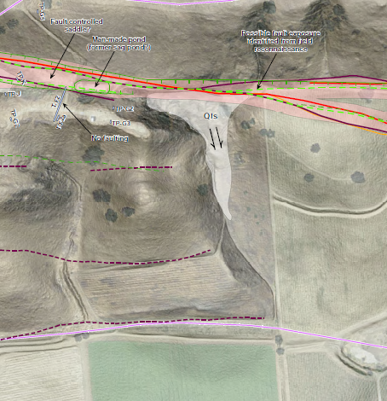
-Madugo

Slide 51
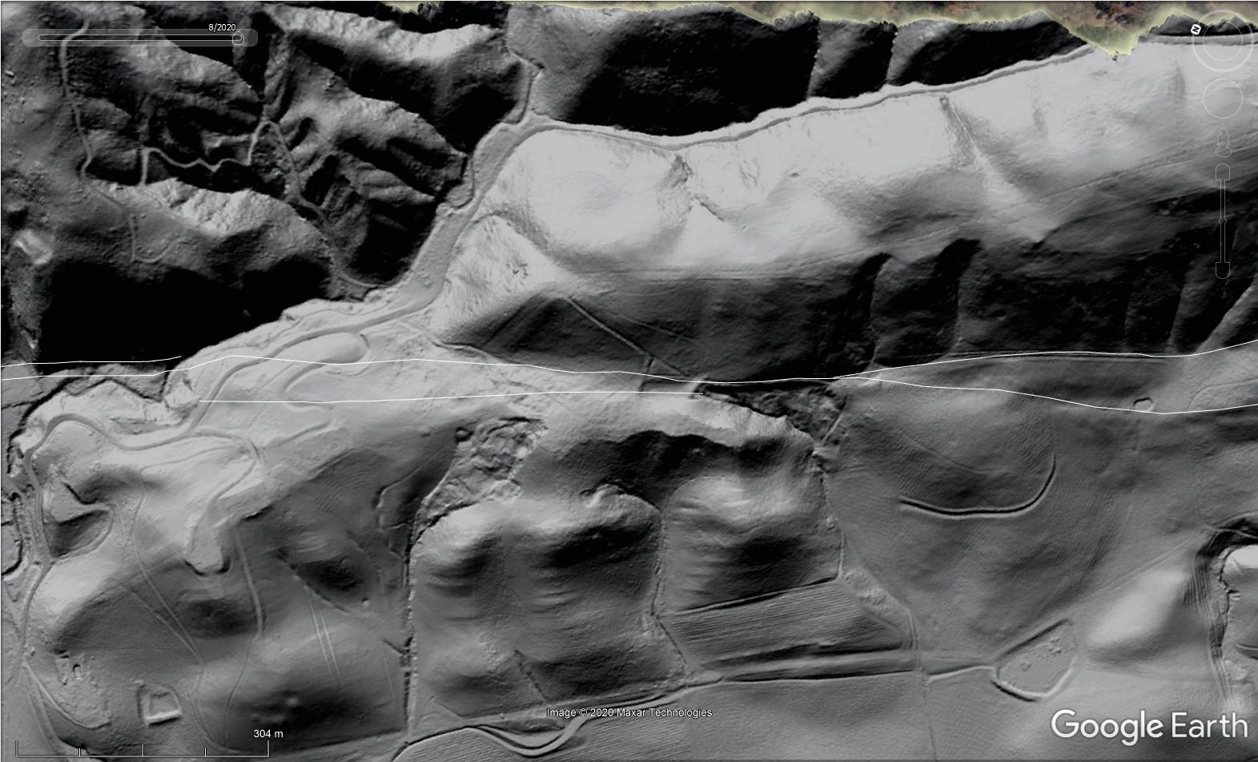
-Madugo

Slide 52
-Madugo

Slide 54
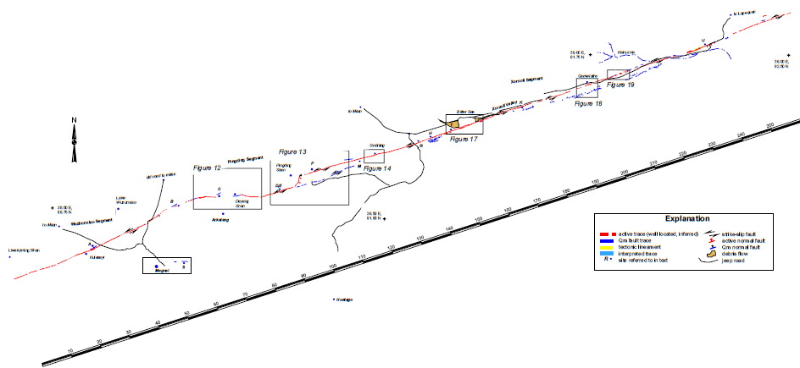
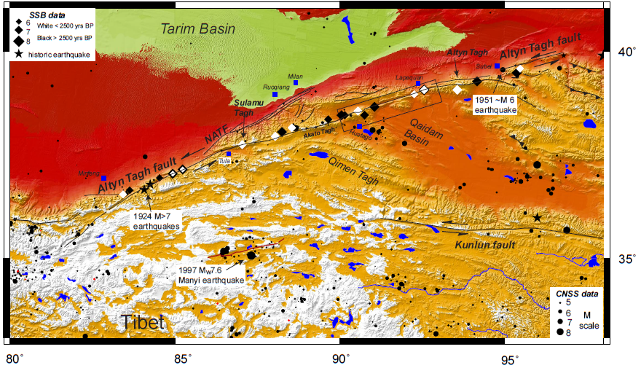
ASU MS thesis 2001

Slide 55
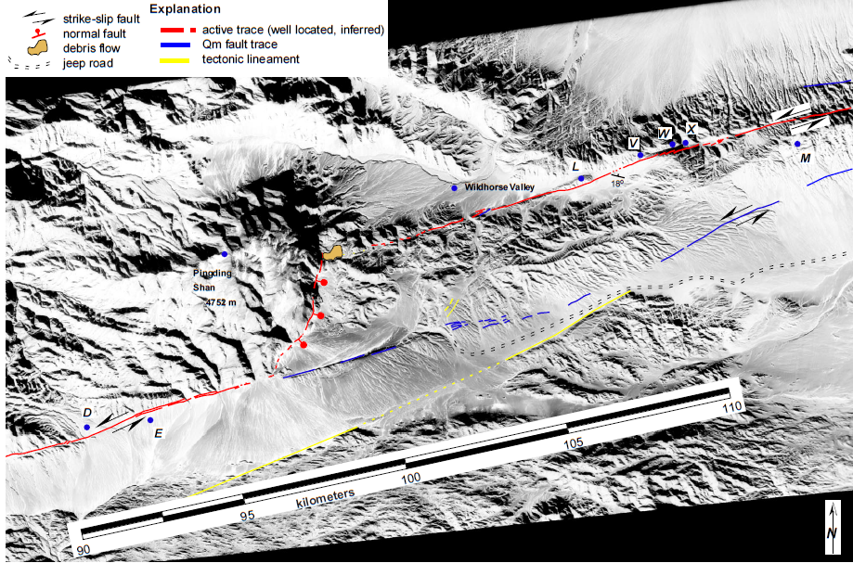

Slide 56
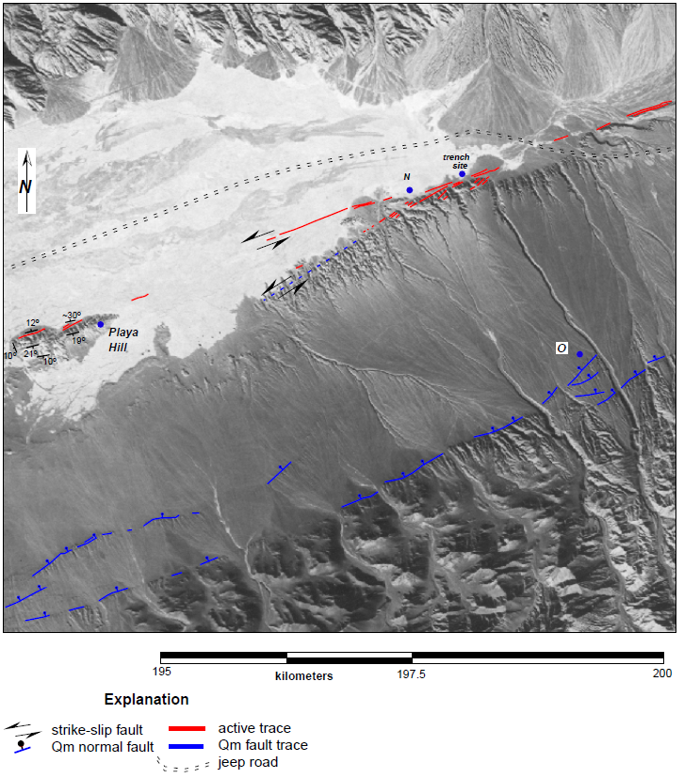

Slide 58
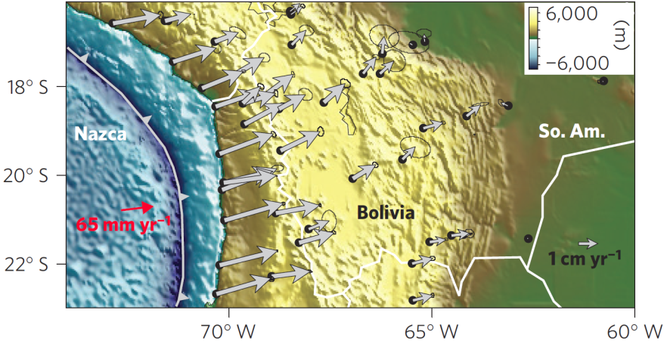
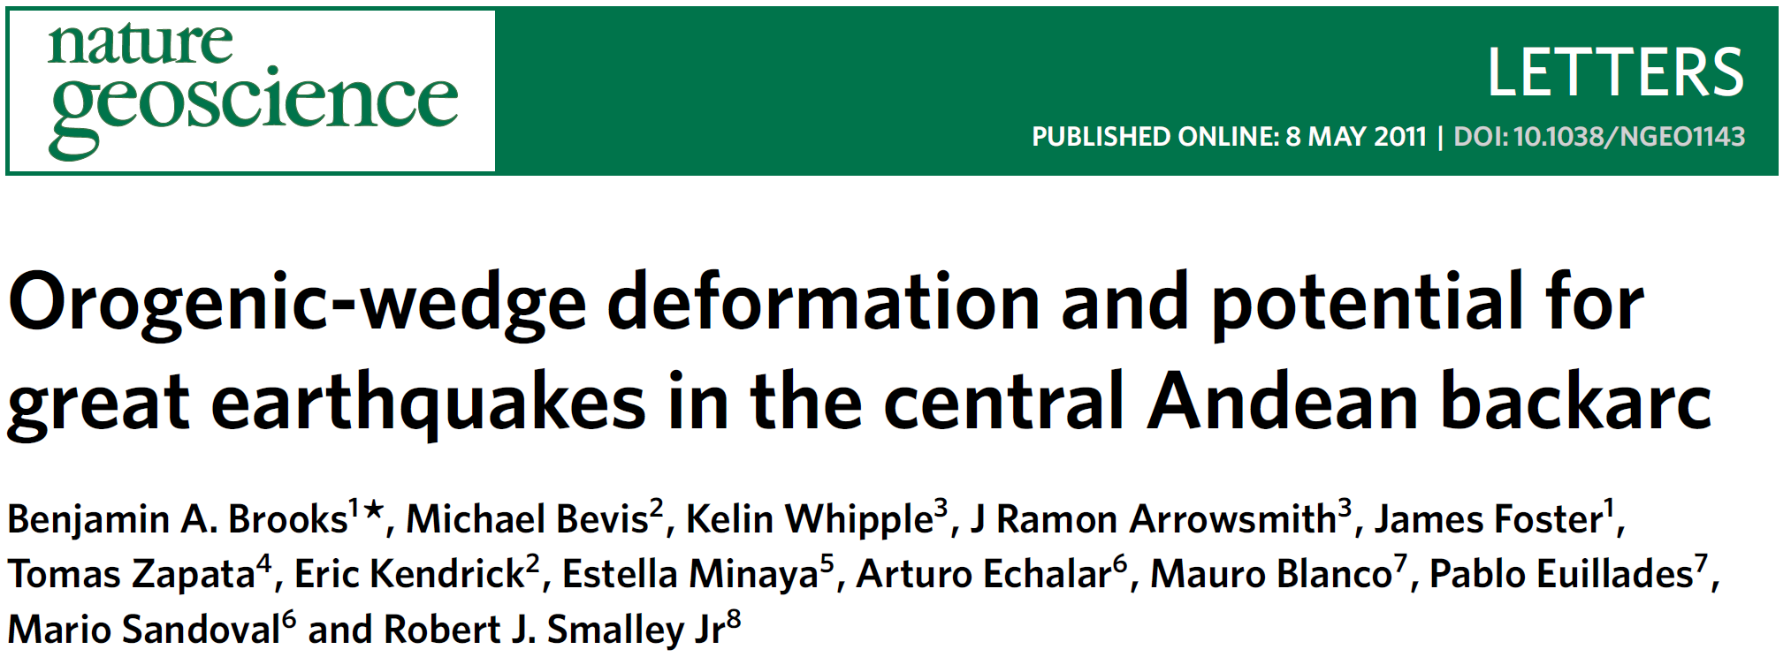
Mandeyapecua thrust fault system (MTFS)

Slide 59
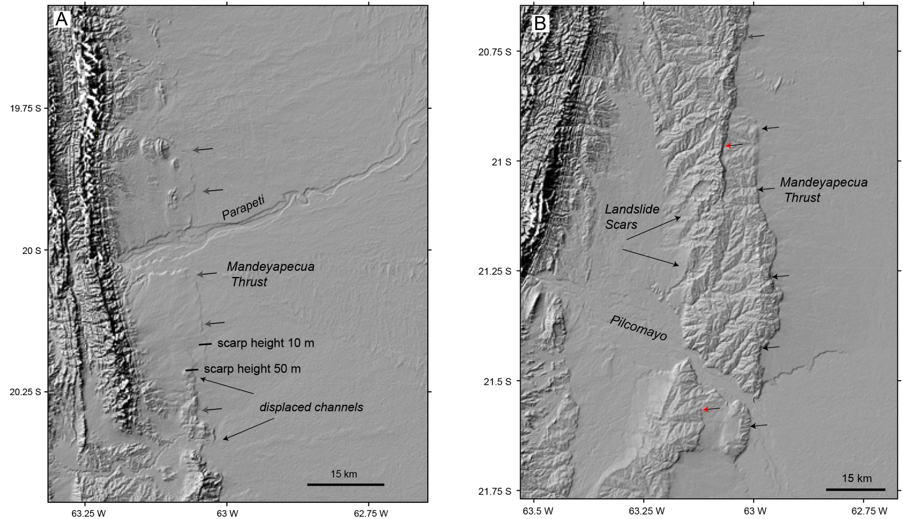
Big fault scarps in SRTM 90 m DEM!

Slide 63
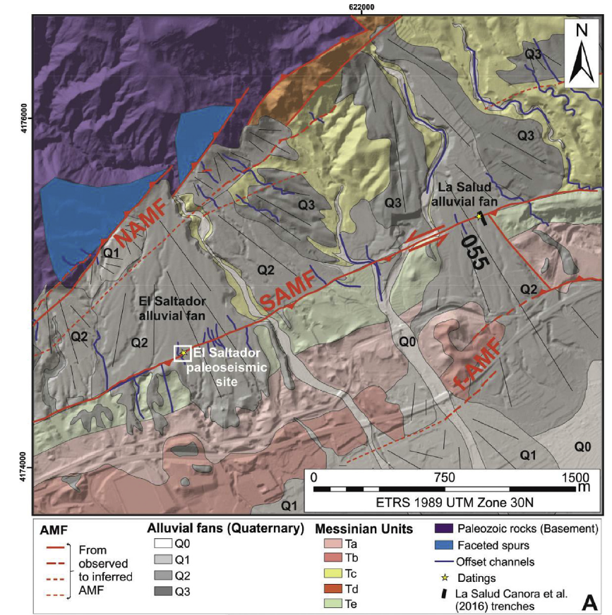
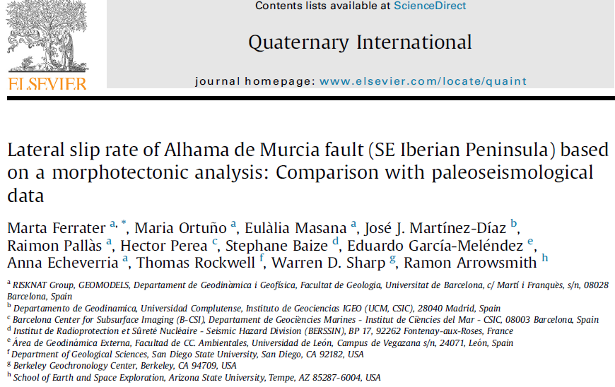

Slide 65
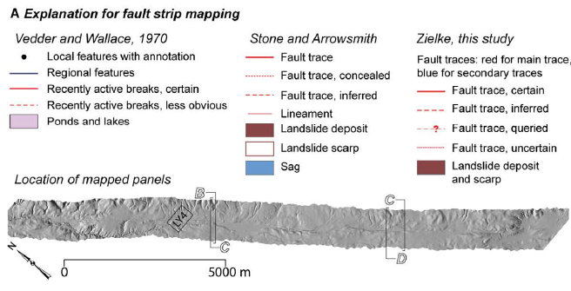
Arrowsmith, J R., and Zielke, O., Tectonic geomorphology of the San Andreas Fault zone from high resolution topography: an example from the Cholame segment, Geomorphology; special issue on high resolution topography, doi:10.1016/j.geomorph.2009.01.002, 2009.

Slide 66
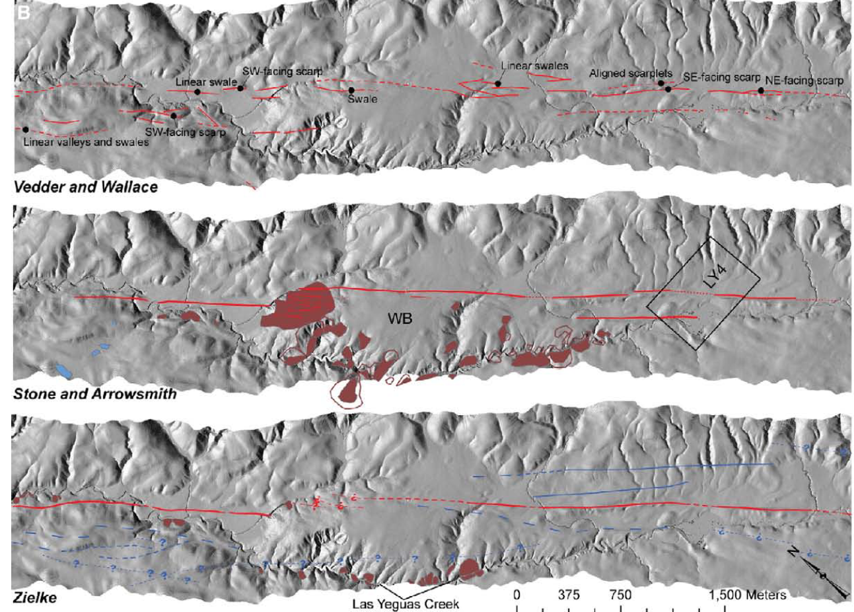

Slide 68
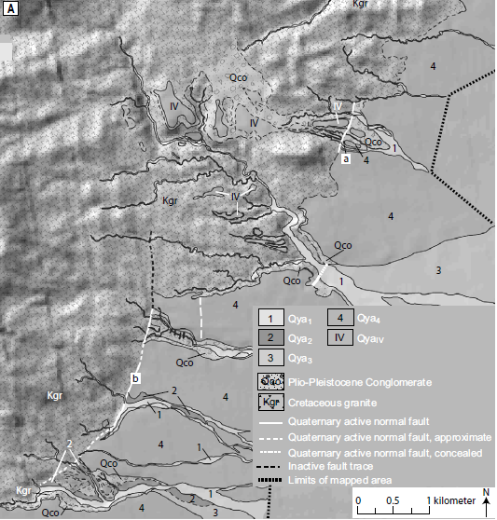
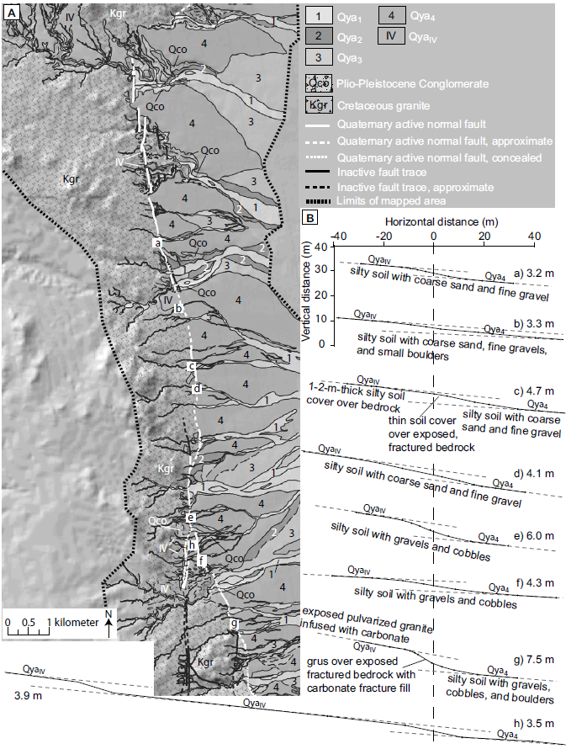
Busch, M., Arrowsmith J R., Umhoefer, P., Coyan, J., Kent, G., Driscoll, N., Martinez Gutierrez, G., Geometry, segmentation, and Quaternary slip behavior of the San Juan de los Planes and Saltito fault zones, Baja California Sur, Mexico: Characterization of rift-margin normal faults, Geosphere, v. 9, p. 426-443, doi:10.1130/GES00806.1, 2013.

Slide 70
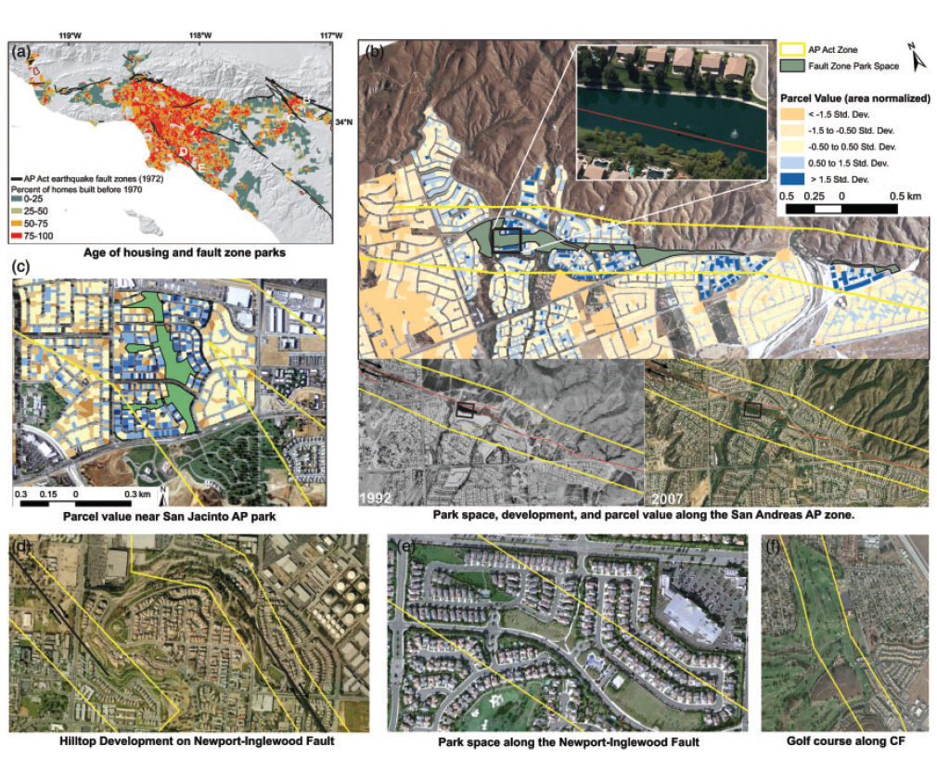
Toke, N. A., Boone, C. G., Arrowsmith, J R., Fault Zone Regulation, Seismic Hazard, and Social Vulnerability in Los Angeles, California: Hazard or Urban Amenity? Earth's Future, Volume 2, Issue 9, Pages: 440-457, DOI: 10.1002/2014EF000241, 2014.

Slide 72
Mapping and image interpretation
Basic considerations for interpretation
Shape: general form, configuration, outline of individual objects.
Size: consider in context of image scale
Pattern: spatial arrangement of objects (e.g., orchard)
Tone: relative brightness or color of objects on an image
Texture: frequency of tonal change (smoothness or coarseness)
Shadows: gives profile view of object and implies relative heights
Site: refers to geographic or topographic location; what do you expect to be there?
Association: occurrence of certain features in relation to others
Resolution: what is the finest thing you can see?
Targets: identify main features you want to emphasize on your map

Slide 73
Mapping
Geomorphic mapping
Important means of establishing landforms, their distributions and relations to each other, process distributions, and history
Quaternary geologic mapping
Emphasis on young deposits and landforms that are usually lumped into one unit in bedrock mapping. Uses both the deposit characteristics as well as the landform shape and position in the landscape as criteria for unit designation.
I cannot work on anything unless I map it first!

Slide 74
Ramón’s Mapping Mantras
Scale: If your pencil is 0.5 mm in diameter, how big on the ground is it if you are mapping on a 1:24,000 scale map? How about on a 1:500,000 map?
Even coverage: if there is blank space, you did not look there.
Strive to provide detail. Do not generalize.

Slide 75
Ramón’s Mapping Mantras
All lines mean something.
Consistent notation and symbology.
Quality control. Use dashing, variable line weights, queries. If something is uncertain or approximate, indicate so.
Data/ink ratio-> 1. Put emphasis on important things (data) by putting relatively more ink in them—greater line weights, larger text., etc.
Neatness counts.

Slide 76
